Slide 1

Web search engine
Intersummer 2022
Final Project
COMP8547 Advanced Computing Concepts
Dr. Mahdi Firoozjaei

Slide 2


Group Members
Yash Somaiya - 110087733
Sherin Tharakan - 110088835
Shreyash Shantam - 110088941
Deepali Gupta - 110088692
Jay Patel - 110067152

Slide 3

Contents
What is a web search engine
Core modules of a search engine
Flow diagram of our search engine
Web Crawler
Keyword Search
HTLML to Text Parsing
Spell Checker
Future Scope
Summary
References

Slide 4
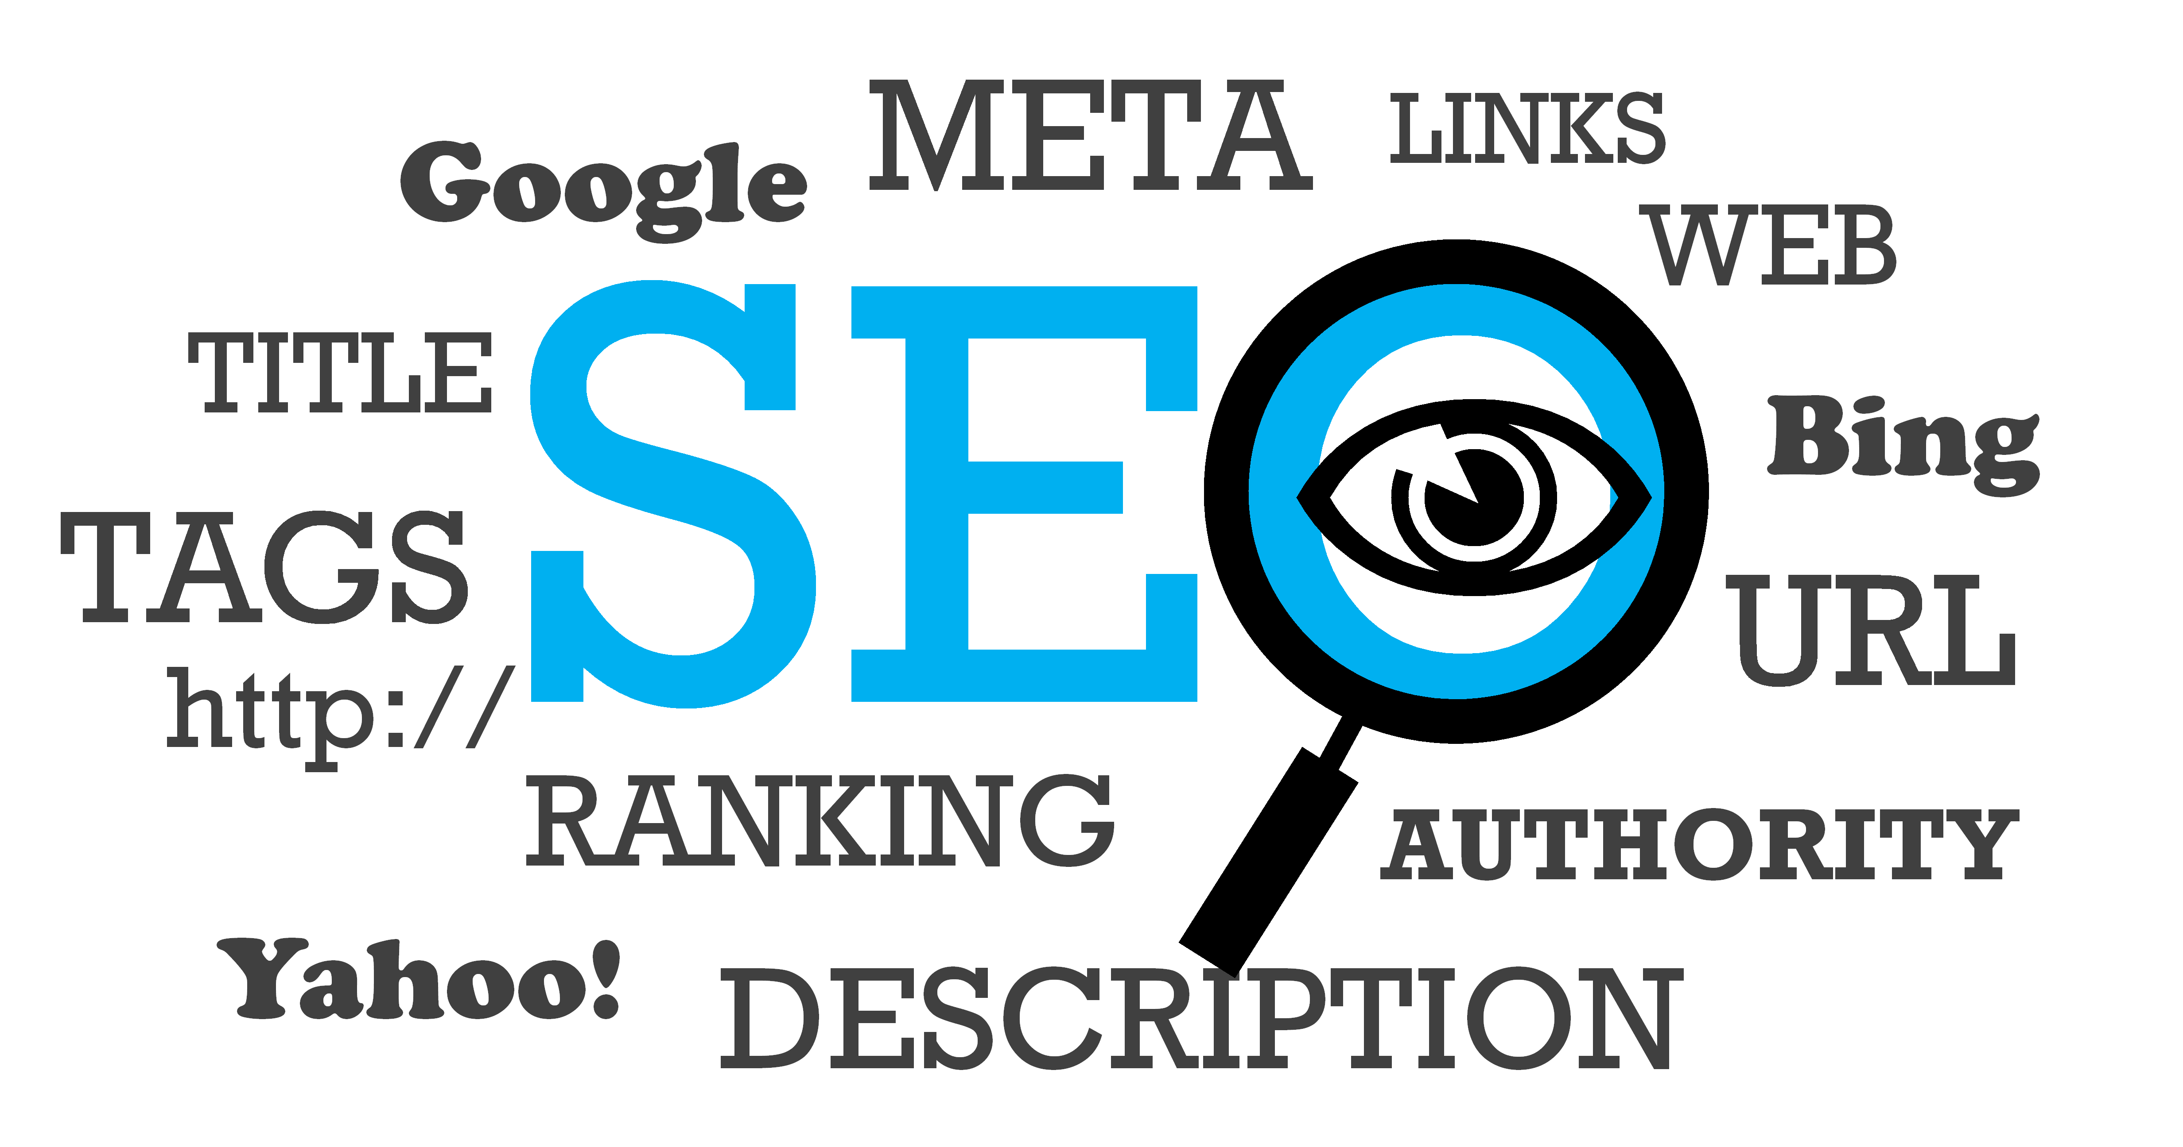
WHAT IS SEARCH ENGINE
A web-based tool that enables users to locate information on the World Wide Web.
A web service that searches the internet (often known as the “WWW") for information based on a user's search.

Slide 5
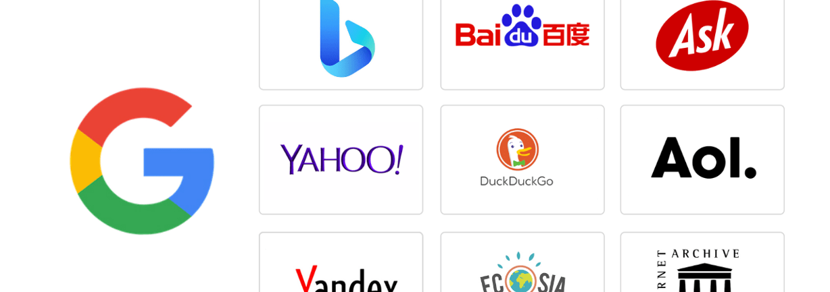
SOME WIDELY USED SEARCH ENGINES

Slide 6
CORE MODULES OF A SEARCH ENGINE
Web Crawler
Keyword Search
Ranking webpages
Spell checking
Scrape and parse of HTML files to both .html and to .txt files

Slide 7
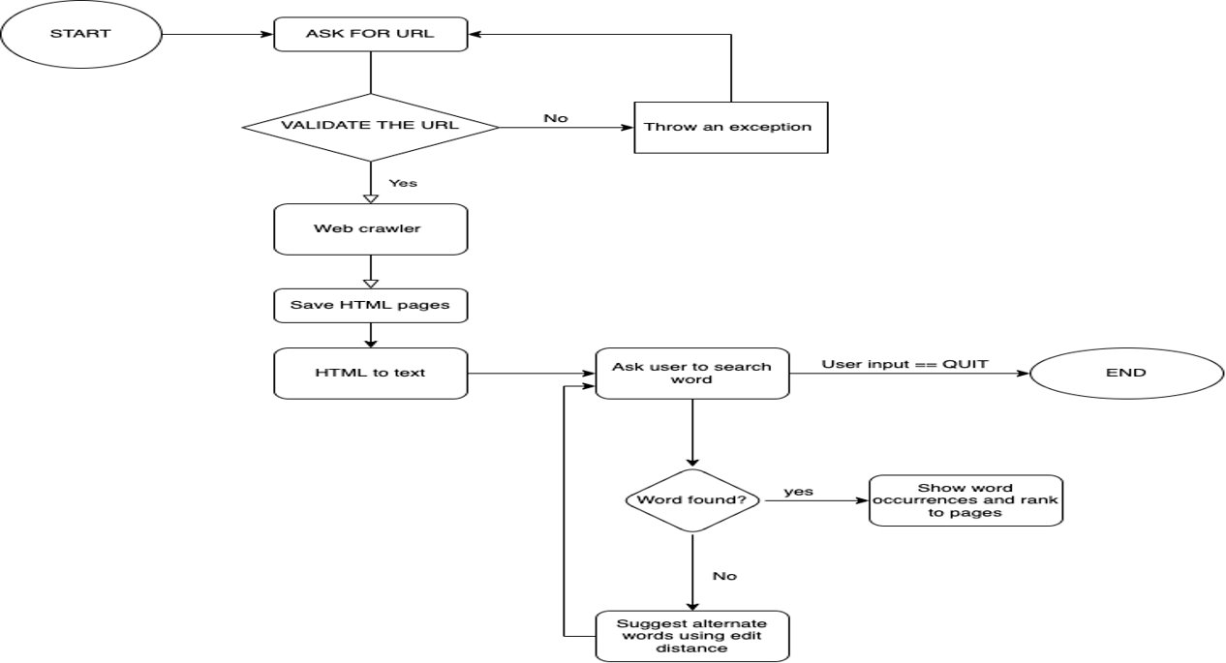
Flowchart

Slide 8
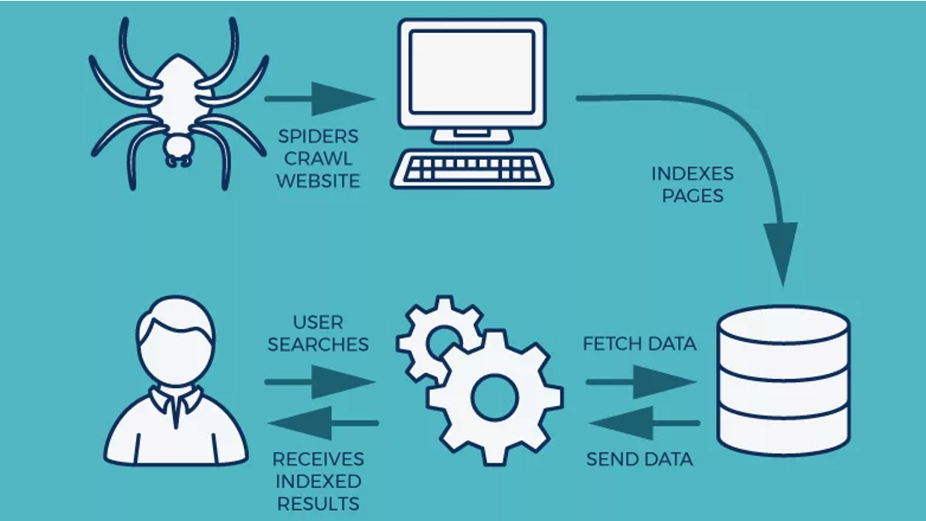
Web Crawler
A web crawler — also known as a web spider — is a bot that crawls across the World Wide Web to find and index pages for search engines.
Popular search engines all have a web crawler, and the large ones have multiple crawlers with specific focuses.
For example, Google has its main crawler, Googlebot, which encompasses mobile and desktop crawling

Slide 9
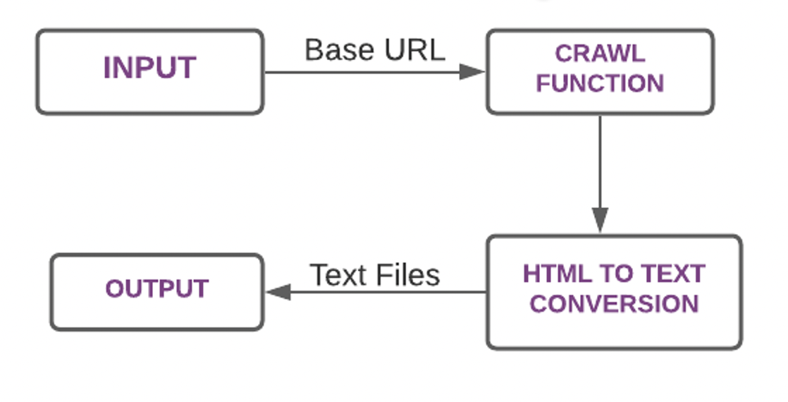
CRAWLER USING JSOUP

Slide 10
WORD FREQUENCY
When the search word is entered, Boyer Moore Algorithm Is used for searching.
It prints all the occurrences of the pattern in the Text.
Web pages with matching words should have its frequency checked.
We find the number of occurances of words using HashTables to store file name and number of occurances.
After checking the text and/or html files, the search engine should mention the frequency of the word typed as well as the link in which this was found.

Slide 11
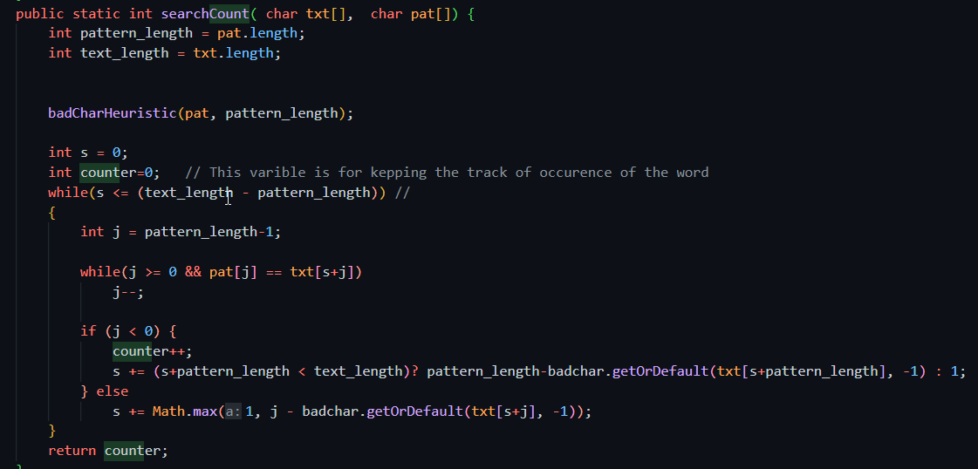
WORD FREQUENCY

Slide 12
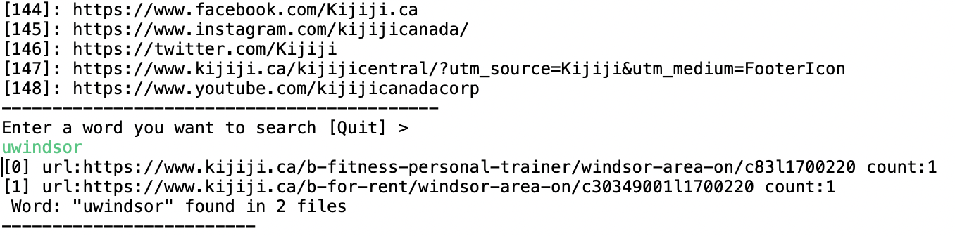
KEYWORD SEARCH
The main concept involved is searching for specific keywords.
Boyer Moore Algorithm Is used for searching.

Slide 13
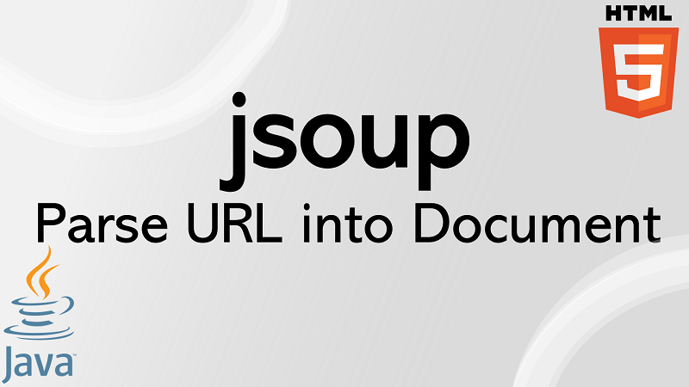
HTML To TEXT PARSING
HTML is the core of the web, all the pages you see on the internet are HTML, whether they are dynamically generated by JavaScript, JSP, PHP, ASP or any other web technology.
Your browser parses HTML and renders it for you. But what would you do, if you need to parse an HTML document and find some elements, tags, attributes or check if a particular element exists or not from Java program.
Libraries used? Jsoup
Jsoup -> Jsoup can scrape and parse HTML from a URL, file, or string

Slide 14
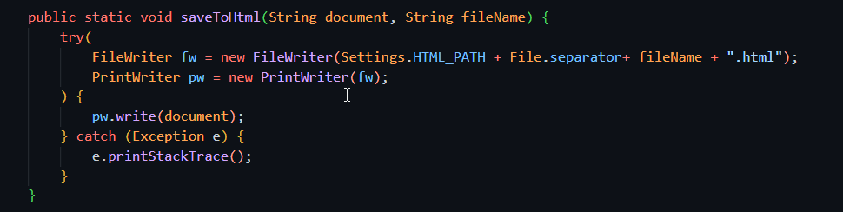
HTML To TEXT PARSING
How it works?
HTML Files are written to a document parsed using jsoup
The document is converted into a text using jsoup parse
A new text file is created and all the converted files are stored to a specific directory

Slide 15
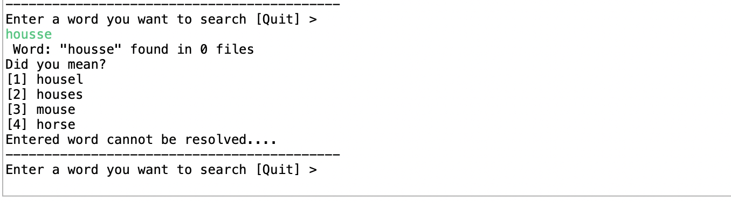
SPELL CHECKER
Spell Checker checks various characters and words for similar patterns by using the edit distance algorithm.
Edit distance algorithm has been used which helps in calculating the length of two strings and compare the length for performing spell checking function.

Slide 16
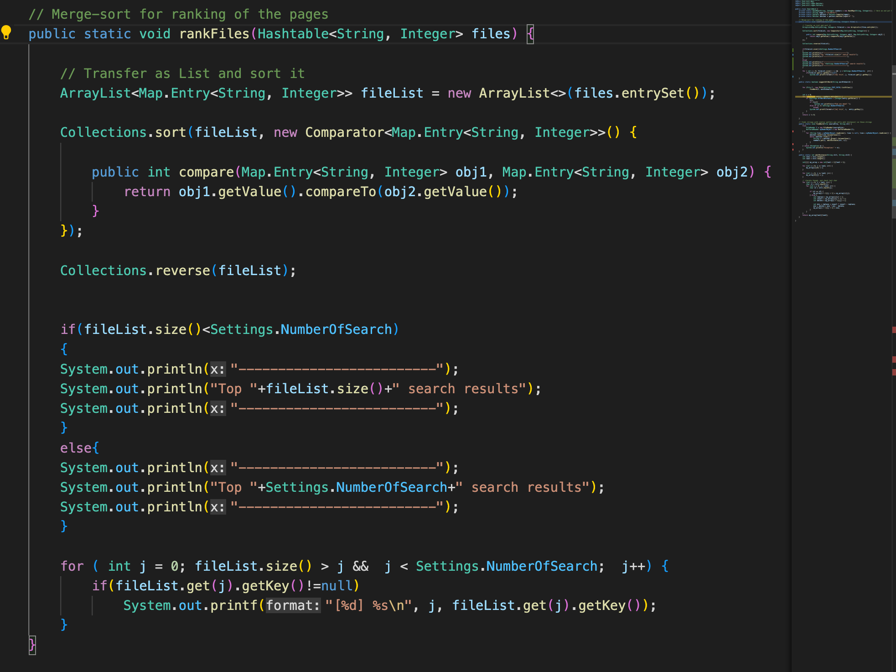
Page ranking
Page ranking is the process to show which HTML links have top occurrences to the searched keyword
We have used merge sort to rank files.

Slide 17
Future scope
Enhance the project to working from a console environment to a web environment or user-friendly interface!
Enhance Auto suggestion feature
Save URL in databases thereby avoiding the need to reparse websites that have no changes
Use regex to search for specific data eg emails, phone numbers

Slide 18
summary
The course COMP 8547 - Advanced Computing Concepts provided both theoretical and practical knowledge of advanced data structures, algorithms, and various analysis related thereto.
The web search engine is developed using various concepts learned in class.
As discussed in the future scope page, there are many enhancements that can be made to this base version of the search engine to make it more efficient and user friendly.

Slide 19
Yash Somaiya – 110087733 – Page Ranking Sherin Tharakan – 110088835 – Spell Check Shreyash Shantam – 110088941 – Web Crawler Deepali Gupta – 110088692 – HTML to text Jay Patel – 110067152 – Keyword Search/Word Frequency
Roles and Responsibilities

Slide 20
references
https://business.yell.com/knowledge/what-is-page-rank-and-why-is-it-important/
https://www.webfx.com/blog/internet/what-is-a-web-crawler/
We have mainly used lecture slides and code references provided by Dr. Mahdi Firozjaaei as our references during this project.

Slide 21
Thank you

